Slide 1


HI6040 (Artificial Intelligence and Machine Learning)
Dr. Farshid Keivanian

Slide 2
Getting Started with Python Scripts in Azure Machine Learning
Objective
Students will run their first Python scripts in the cloud using Azure Machine Learning. The focus is not on building a model but on understanding AzureML's interface, compute setup, and script execution.
If AzureML is not working, Anaconda (for beginners) and VS Code (for those with some background) are alternative options.
Your Password to connect WiFi is your Holmes webmail password, or HiDD/MM/YYYY

Slide 3
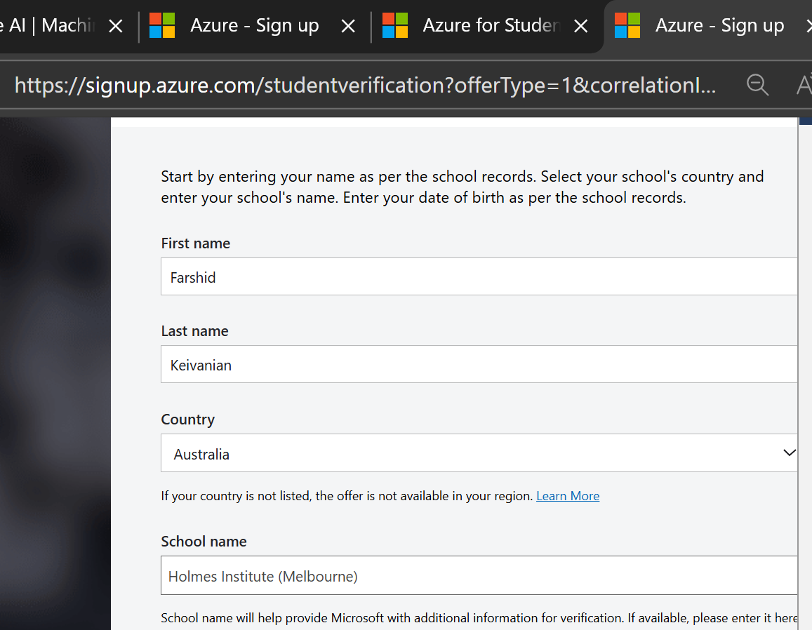
STEP-BY-STEP GUIDE
Step 0: Prerequisites
Make sure you’ve (coordinator/IT team):
Completed the Azure ML Setup (workspace, compute instance, and cluster) https://azure.microsoft.com/en-us/free/students/
Installed Python 3.6 or 3.7 (required for AzureML compatibility)
Have internet access and your Azure ML login ready

Slide 4
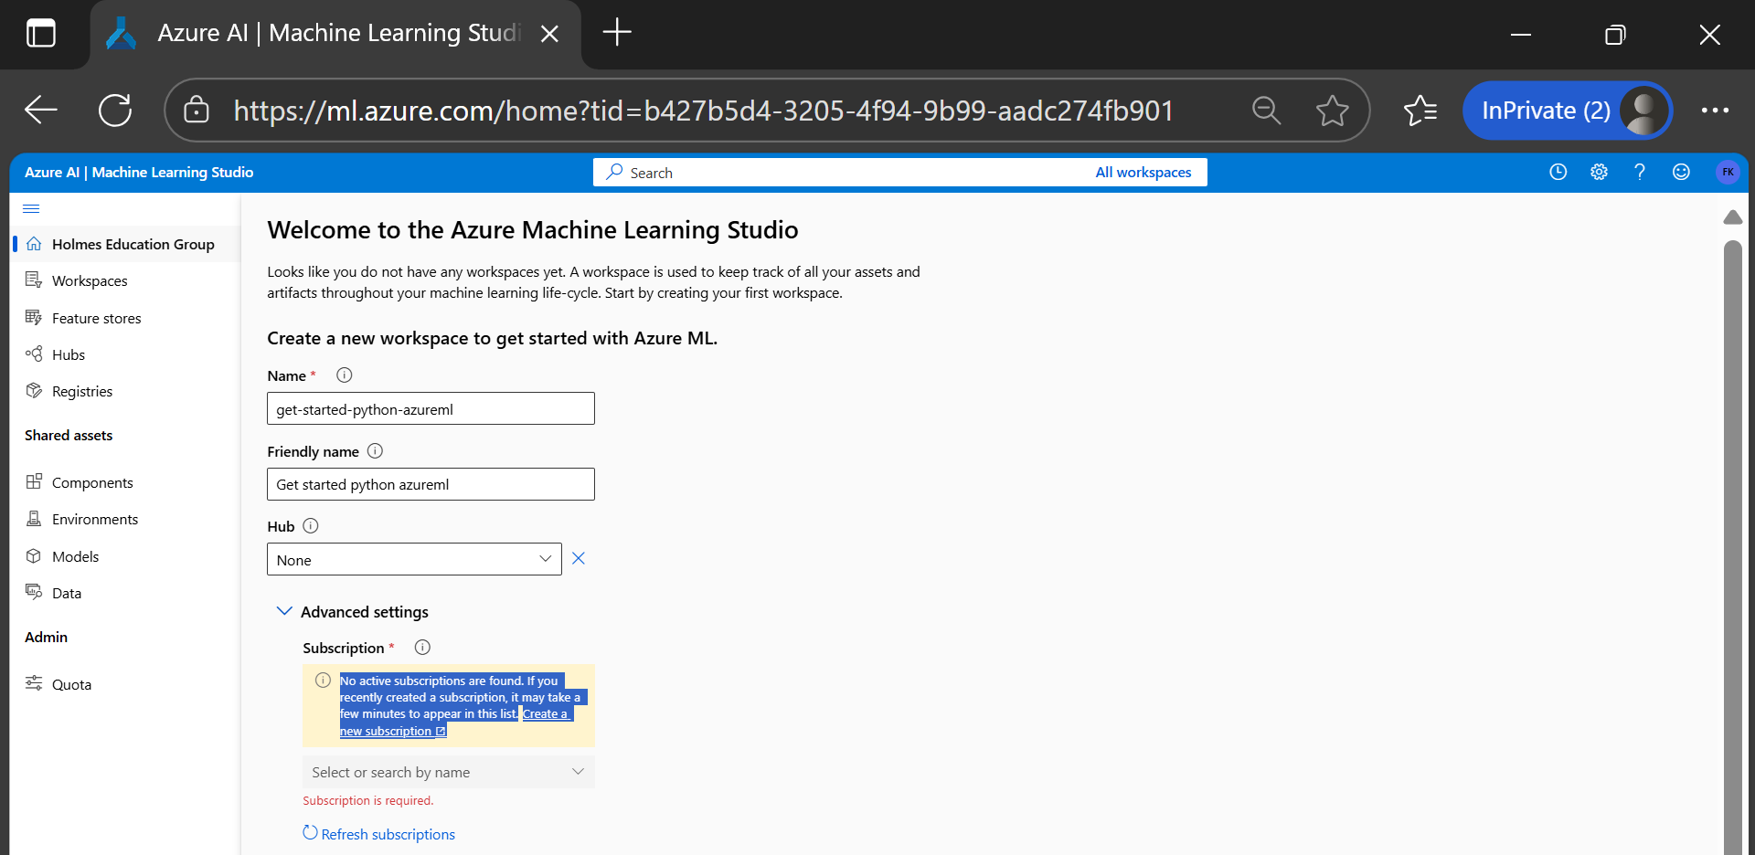
STEP-BY-STEP GUIDE
Step 1: Login and Setup Folders
Log in to: https://ml.azure.com/ |
Select your workspace
On the left panel, click Notebooks
Click the + sign → Create new folder → name it: get-started
Click ... next to get-started → Create subfolder → name it: src

Slide 5
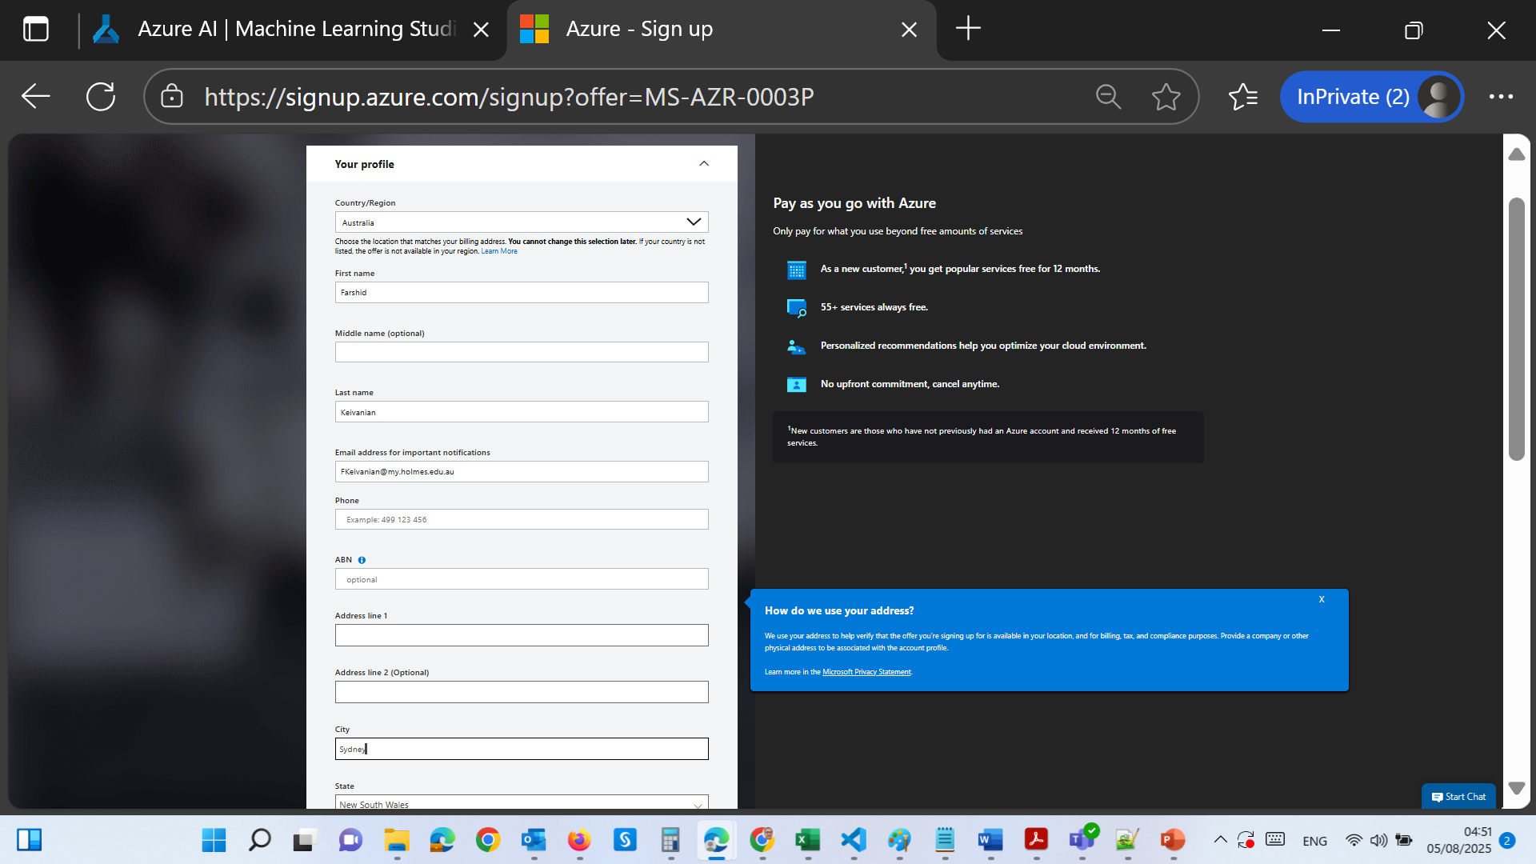
STEP-BY-STEP GUIDE

Slide 6
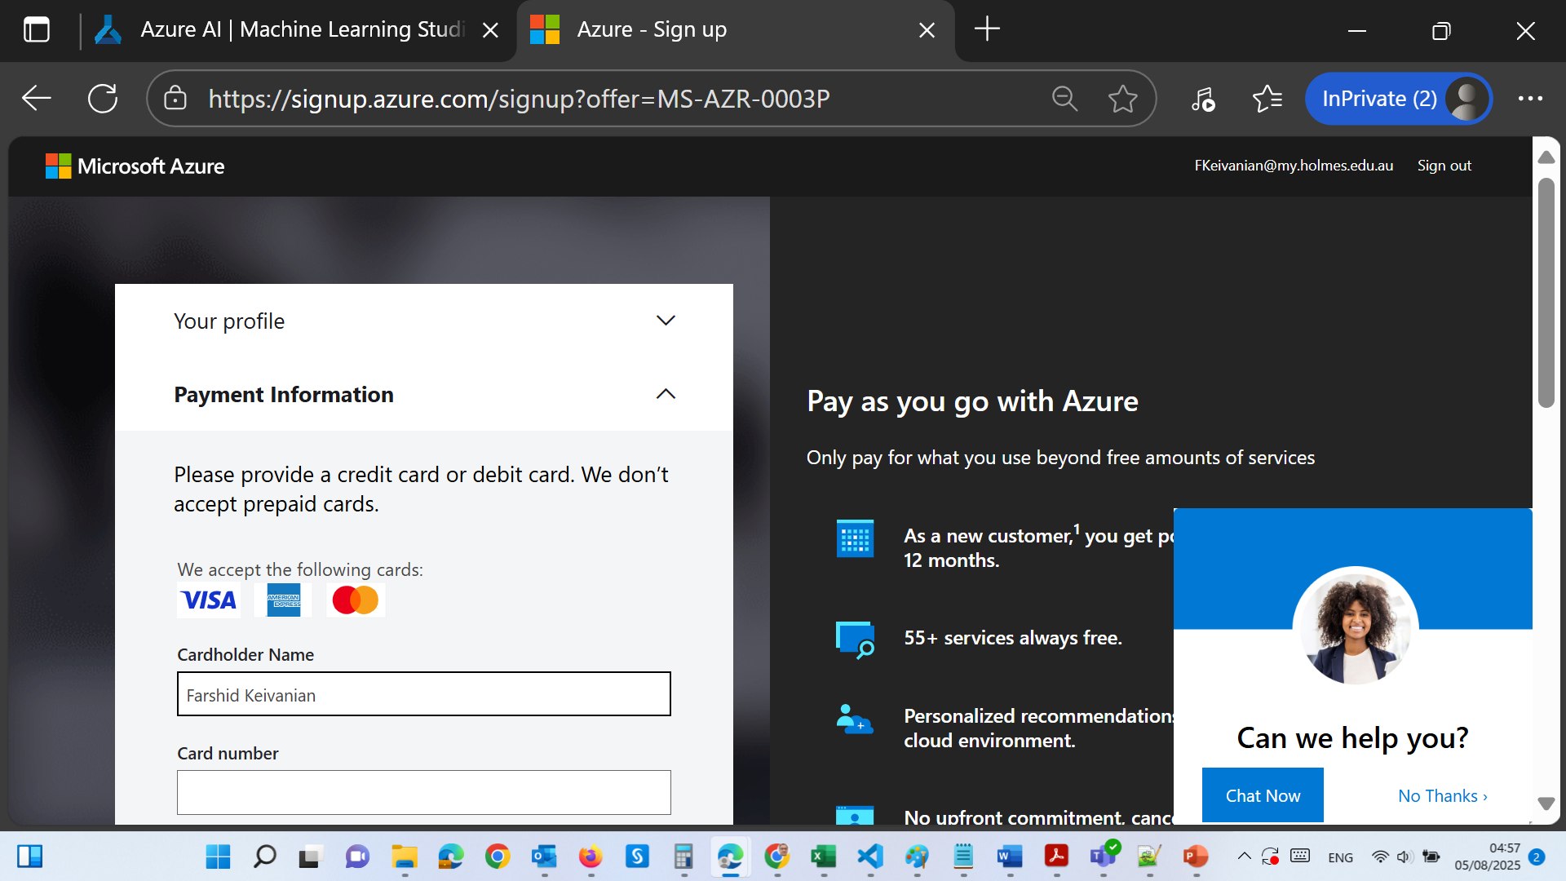
STEP-BY-STEP GUIDE

Slide 7
STEP-BY-STEP GUIDE
Step 2: Write First Python Script
Click ... next to src → Create new file
Name it: hello.py and select type: Python (.py)
Write this code:
# src/hello.py
print("Hello world!")

Slide 8
STEP-BY-STEP GUIDE
Save and run it using: "Save and run script in terminal"
You should see Hello world! printed in the terminal.

Slide 9
STEP-BY-STEP GUIDE
Step 3: Create the Control Script
This will run your script in the cloud (not just on your compute instance).
Click ... next to get-started → Create new file Name it: run-hello.py
Write the following:
from azureml.core import Workspace, Experiment, Environment, ScriptRunConfig
ws = Workspace.from_config()
experiment = Experiment(workspace=ws, name='day1-experiment-hello')
config = ScriptRunConfig(source_directory='./src',
script='hello.py',
compute_target='cpu-cluster')
run = experiment.submit(config)
aml_url = run.get_portal_url()
print(aml_url)
Note: Replace 'cpu-cluster' if you named your cluster differently.

Slide 10
STEP-BY-STEP GUIDE
Step 4: Run the Control Script
Click on run-hello.py → Save and run script in terminal
It may ask you to authenticate:
Copy the URL and code shown.
Paste into your browser and complete sign-in.
Once authenticated, a URL will be printed in the terminal → Click it to monitor your script in Azure ML Studio.

Slide 11
STEP-BY-STEP GUIDE
Step 5: View Output Logs
On the experiment run page, wait for status: Completed
Click on "Outputs + logs"
Open std_log.txt → You’ll see:
Hello world!
This confirms your cloud script executed successfully!

Slide 12
Optional Exercises (Extended Practice)
Examples for Students to Try:
(Replace the code in src/hello.py each time)
1. Area of a Triangle
a = 5
b = 6
c = 7
s = (a + b + c) / 2
area = (s*(s-a)*(s-b)*(s-c)) ** 0.5
print('The area of the triangle is %0.2f' % area)

Slide 13
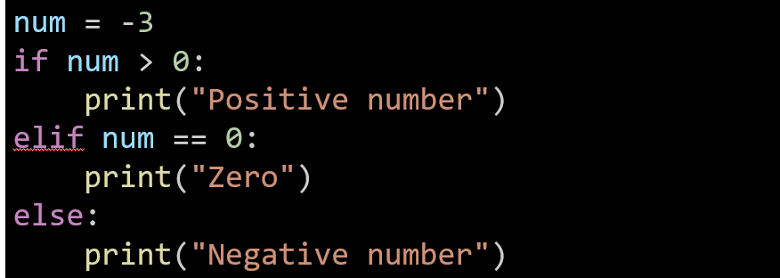
Optional Exercises (Extended Practice)
2. Check Positive/Negative

Slide 14
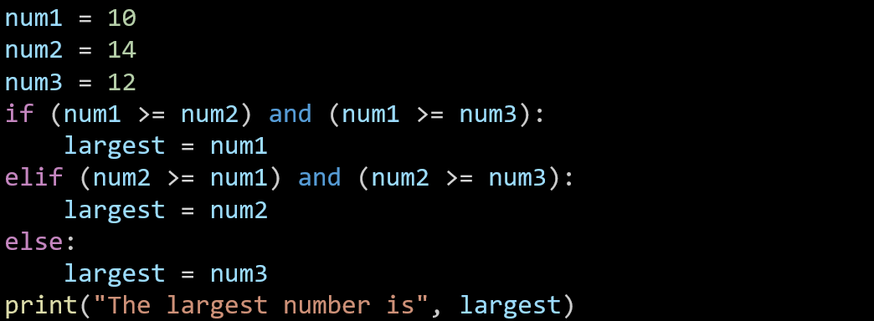
Optional Exercises (Extended Practice)
3. Largest of Three

Slide 15
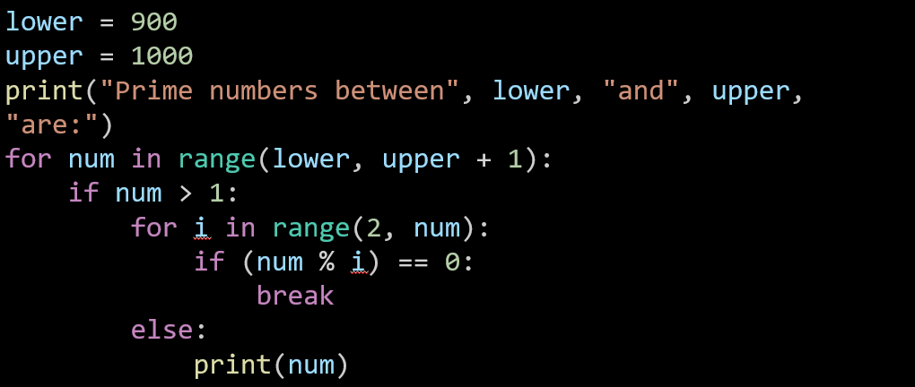
Optional Exercises (Extended Practice)
4. Prime Numbers in a Range

Slide 16
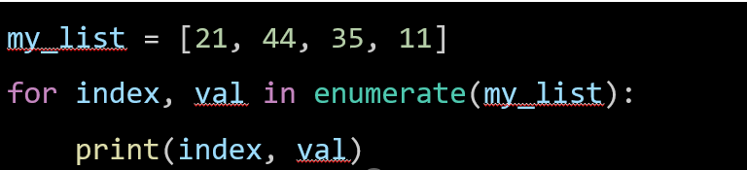
Optional Exercises (Extended Practice)
5. Accessing Index of List
And so on for the other examples from tutorial material on the blackboard

Slide 17
Optional Exercises (Extended Practice)
Summary
Task | Status
Setup folders and script in Azure | Done
Run basic Python script | Done
Submit via control script to cloud | Done
View outputs/logs on Azure | Done
Practice with new Python code | Keep Going

Slide 18
Final Tip for Students
If the script runs successfully and shows output in the std_log.txt file on Azure ML Studio, you're on the right path. Each script you run will build your confidence working with cloud-based ML environments.

Slide 19
Thank You
Need Help with coding? Send an email during the tutorial session.
FKeivanian@my.holmes.edu.au

